Slide 1
State Management in Blazor

Slide 2
Understanding State Management
State Management Options:
Browser storage (session/local), In-memory state, Service-based state

Slide 3
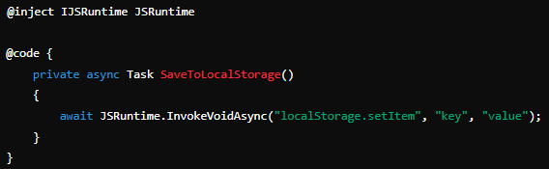
Session and Local Storage

Slide 4
Service-Based State Management
Objective: Use a service to manage state that can be shared across multiple components. This approach is suitable for more complex scenarios where state needs to be accessed or modified by different parts of the application.

Slide 5
In-Memory State Management
Scenario: Create a simple counter that increments a value and displays it. The counter value is managed within the component's memory.

Slide 6
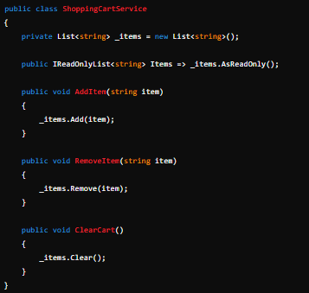

Slide 7
builder.Services.AddSingleton<ShoppingCartService>();
Lifetime: Registering the service as Singleton ensures that the same instance is used throughout the application, maintaining state consistency.

